Slide 1
Hackathon Presentation
by
Odetocode
ML4Science,202

Slide 2
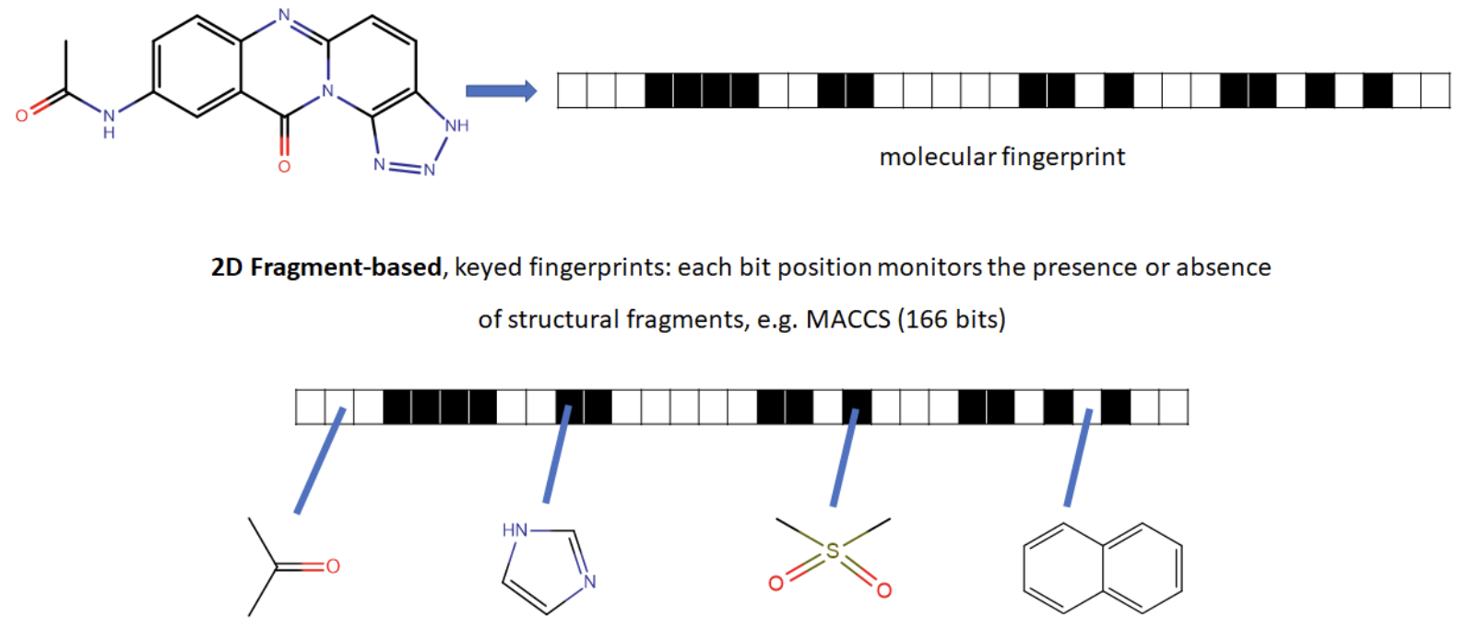
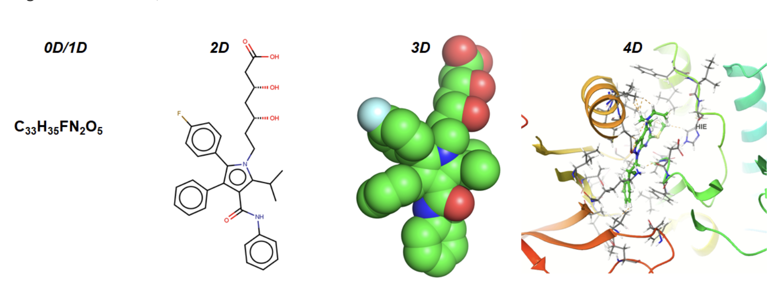
Computing Molecular Descriptors:

Slide 3
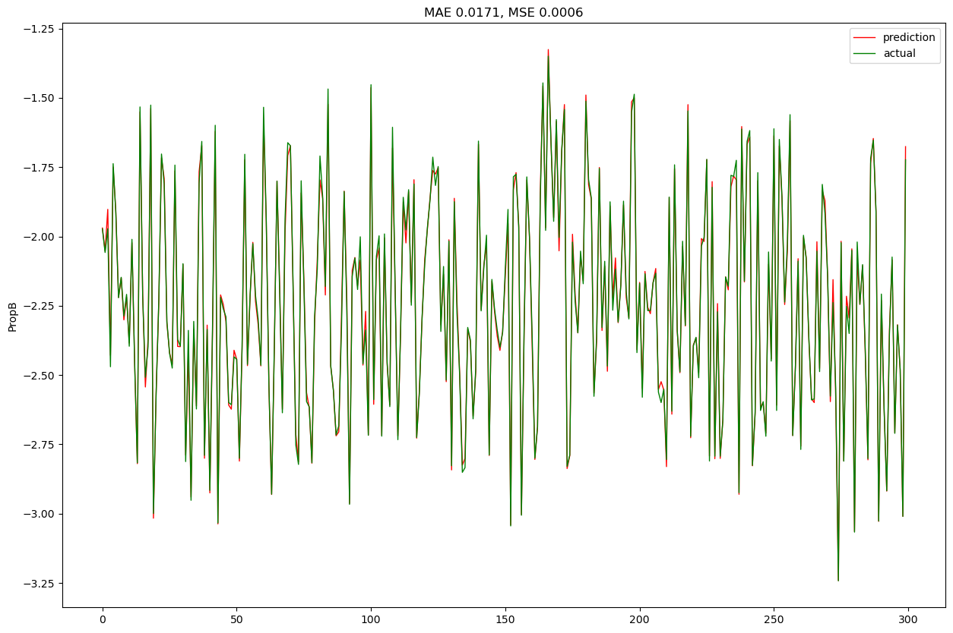
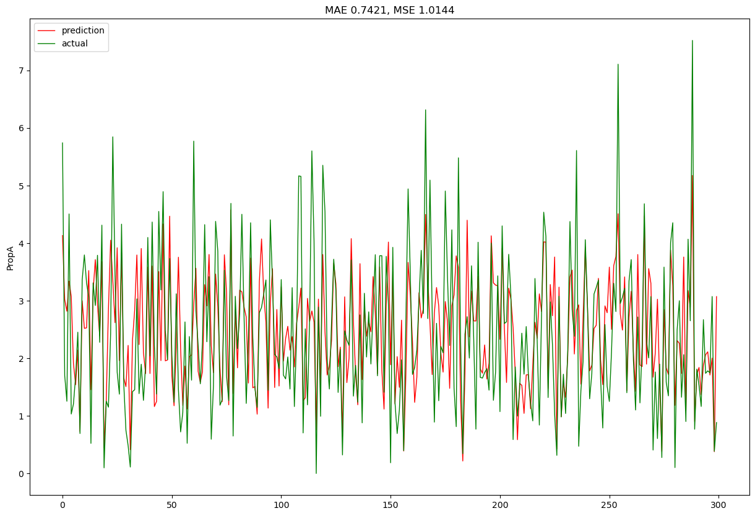
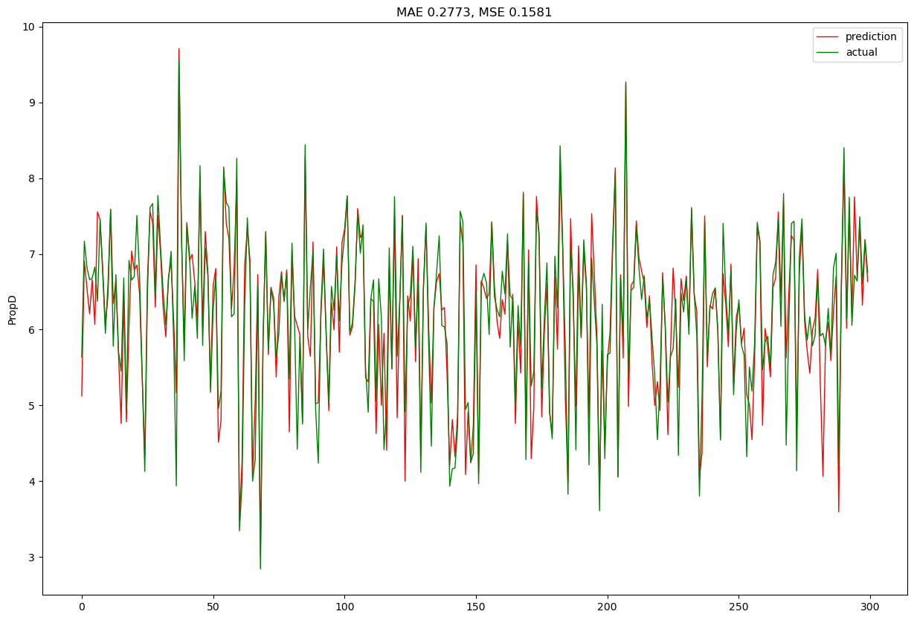
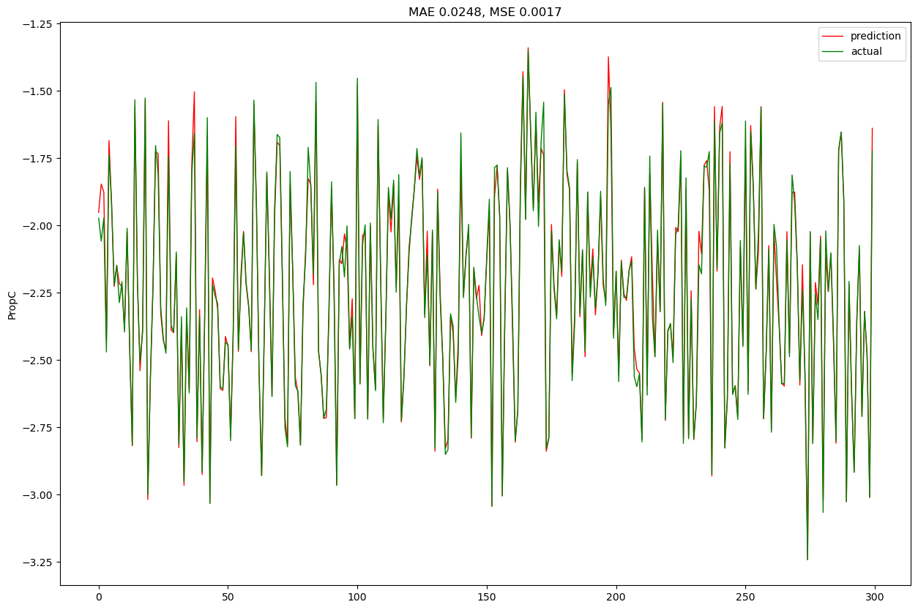
RandomForestRegressor,RidgeCV
Train-split: 90%-10%, 5 CV
R2 score (Train) | R2 score (Evaluation)
0.91 | 0.42
0.93 | 0.89
0.99 | 0.99
0.93 | 0.87

